Slide 1
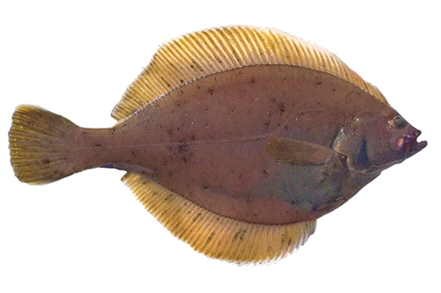
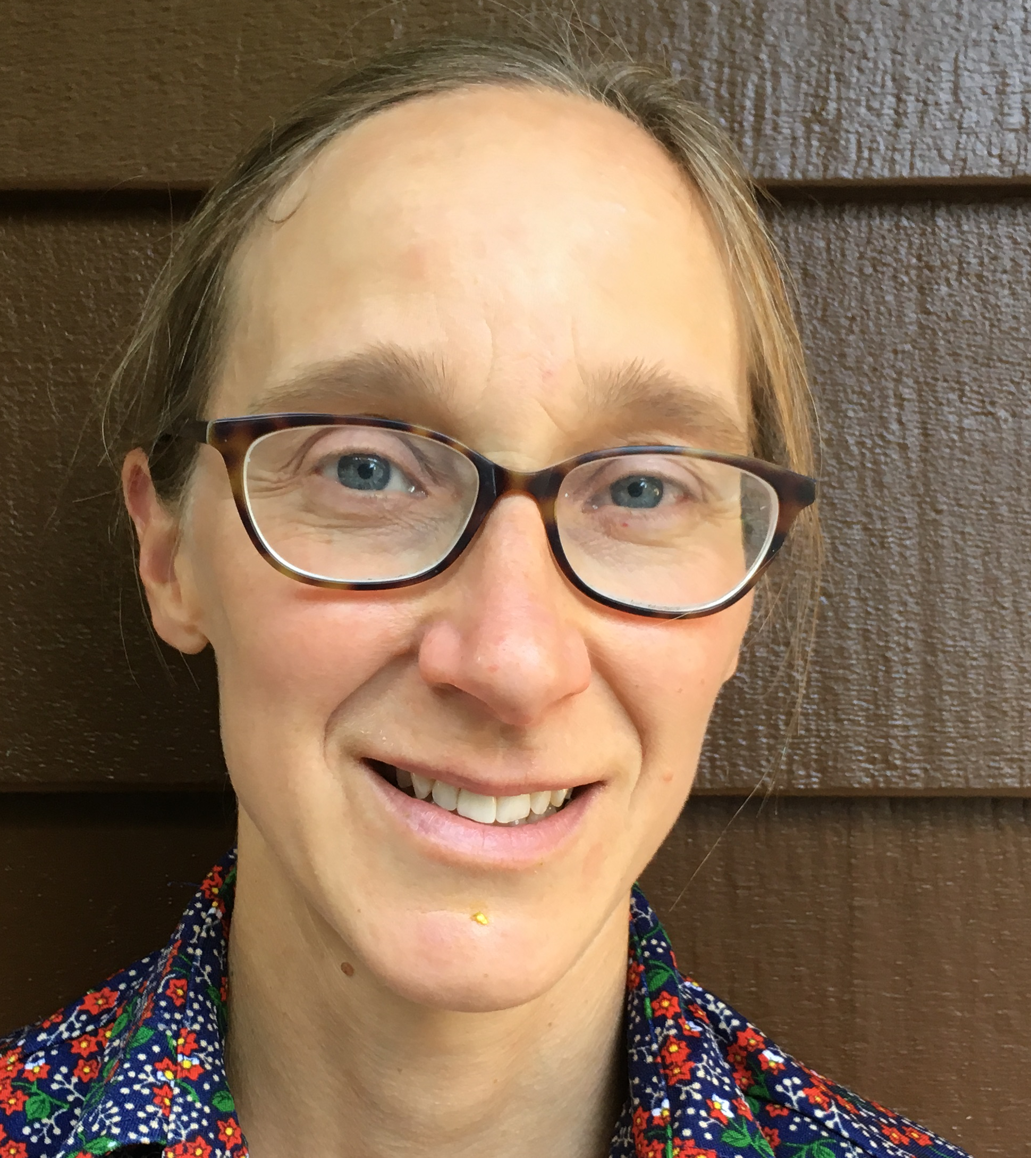
Model evaluation for Plan Team consideration for the Yellowfin Sole Stock in the Bering Sea and Aleutian Islands
Ingrid Spies and James Ianelli
September 9, 2020
Ingrid Spies

Slide 2
Why are we presenting this model?
SSC and Plan Team Comments:
In their December 2019 minutes the SSC concurred with the Plan Team’s recommendation to use Model 18.1a for management in 2020, as Model 18.2 had not received thorough review.
In response we have prepared this update.
Ingrid Spies

Slide 3
Two models will be presented for consideration.
Model 18.1a: Same model as in the 2018 assessment, updated with 2019 data. Model 18.1a used the same natural mortality for males and females, M=0.12.
Model 18.2: Uses a fixed value for female natural mortality (M=0.12) and allowed male natural mortality to be estimated within the model. Model 18.2 is the preferred model.
Ingrid Spies

Slide 4
The SSC requested the authors clarify and justify why natural mortality M is estimated in the model for males, rather than for females or both sexes, and whether the value previously used for both sexes combined (M=0.12) is appropriate for a single sex.
First step towards examining sex-specific M for Yellowfin sole.
Skewed sex ratio in Yellowfin Sole, other flatfish -> evidence for higher male M.
Sex-specific M -> common feature for flatfish (e.g. Arrowtooth Flounder).
High proportion of females -> better understanding of female M.
Female M: 0.10 to 0.33, Male M: 0.16 to 0.51 (Wilderbuer and
Turnock 2009).
Assumptions in Model 18.2 based on best available information.
Ingrid Spies

Slide 5
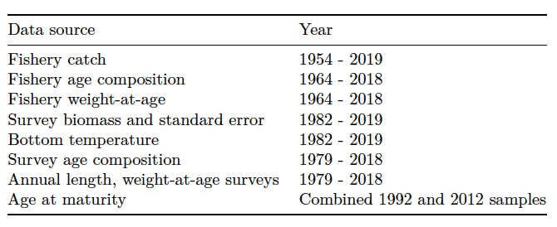
Data included in the models:
Ingrid Spies

Slide 6
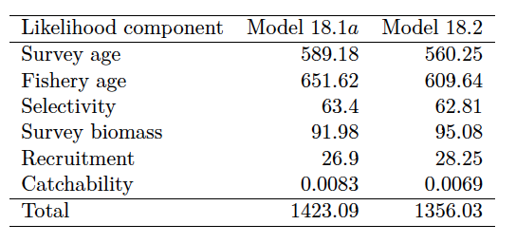
Likelihood table for Model 18.1a and Model 18.2
Ingrid Spies

Slide 7
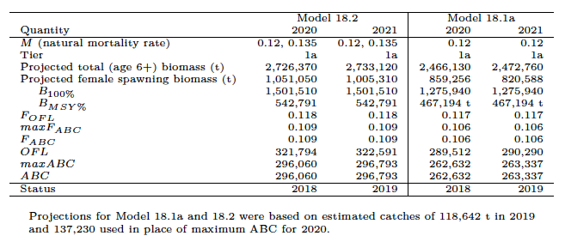
Comparison of results for Model 18.1a and Model 18.2
Ingrid Spies

Slide 8
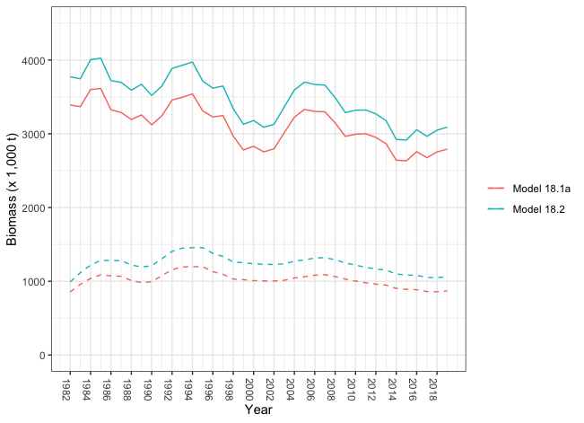
Estimates of total (solid line) and spawning (dotted line) biomass, Model 18.2a and Model 18.2, 1982-2019
Model 18.1a
Model 18.2
Ingrid Spies

Slide 9
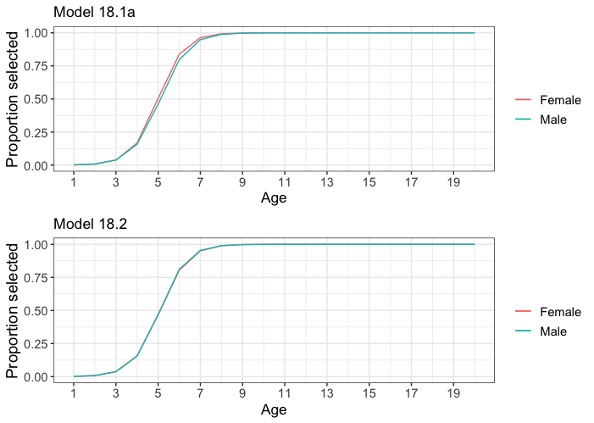
Similar survey selectivity for males and females, Models 18.1a and 18.2
Model 18.1a
Model 18.2
Ingrid Spies

Slide 10
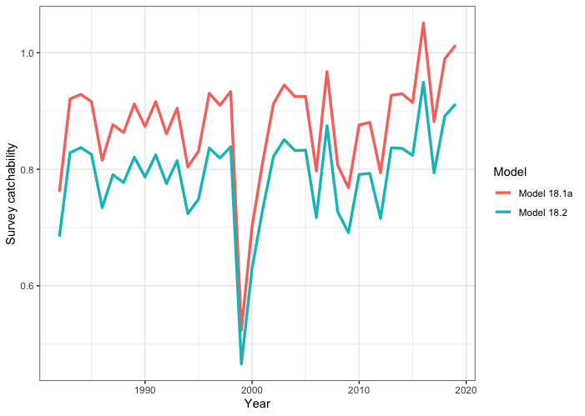
Survey catchability for Model 18.1a and 18.2, 1982-2019.
Model 18.1a
Model 18.2
Ingrid Spies

Slide 11
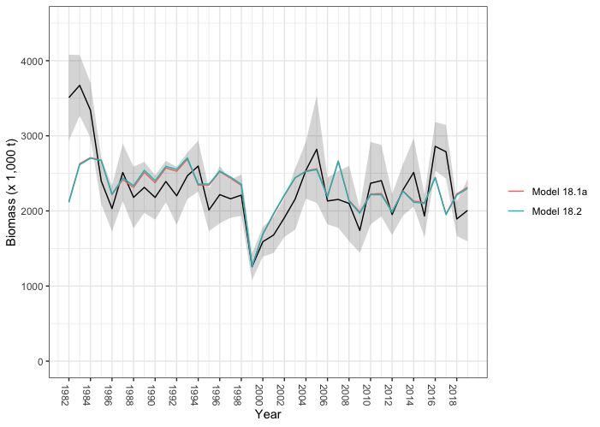
NMFS EBS survey biomass estimates, Model 18.1a and 18.2 fit to survey biomass estimates, 1982-2019.
Model 18.1a
Model 18.2
Ingrid Spies

Slide 12
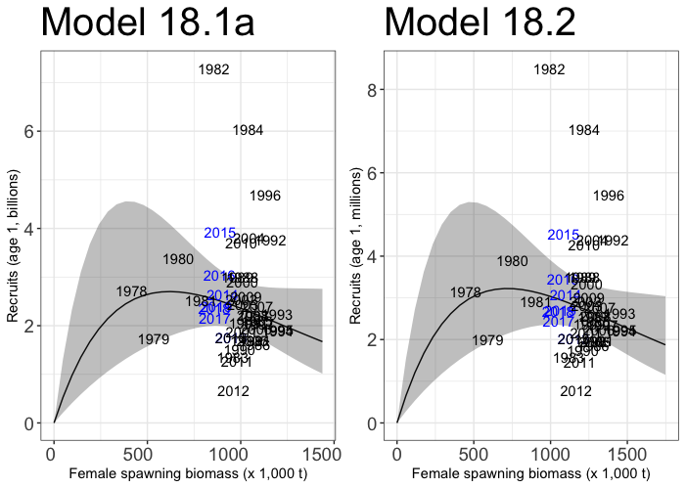
Ingrid Spies

Slide 13
Fit to the time-series of survey age composition, by sex, 1979-2018, Models 18.2 and 18.1a.
Ingrid Spies

Slide 14
Ingrid Spies

Slide 15
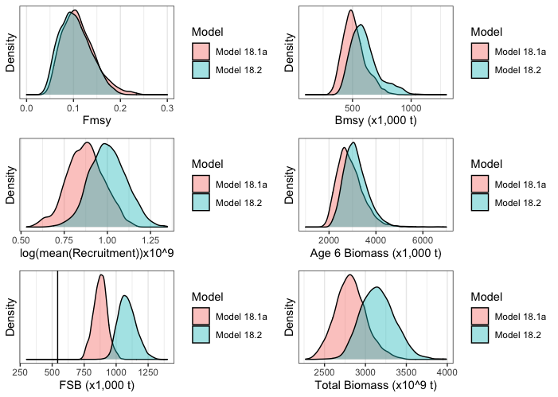
MCMC posterior distributions for Models 18.1a and 18.2.
Ingrid Spies

Slide 16
Retrospective plots of female spawning biomass
Ingrid Spies

Slide 17
Relative difference in FSB between recent model and retrospective runs
Ingrid Spies

Slide 18
Retrospective results
Mohn’s rho was -0.219 using Model 18.2 and -0.254 under Model 18.1a.
Retrospective differences were almost always negative under Model 18.1a but more balanced under 18.2.
Ingrid Spies

Slide 19
Conclusions
Model 18.2 has several characteristics that indicate it is a better model than 18.1a.
Higher male natural mortality is accepted for the population dynamics of other flatfish species.
Model 18.2 has higher total likelihood.
Model 18.2 has an improved difference in female spawning biomass retrospective patterns and less negative Mohn's rho.
Ingrid Spies

Slide 20
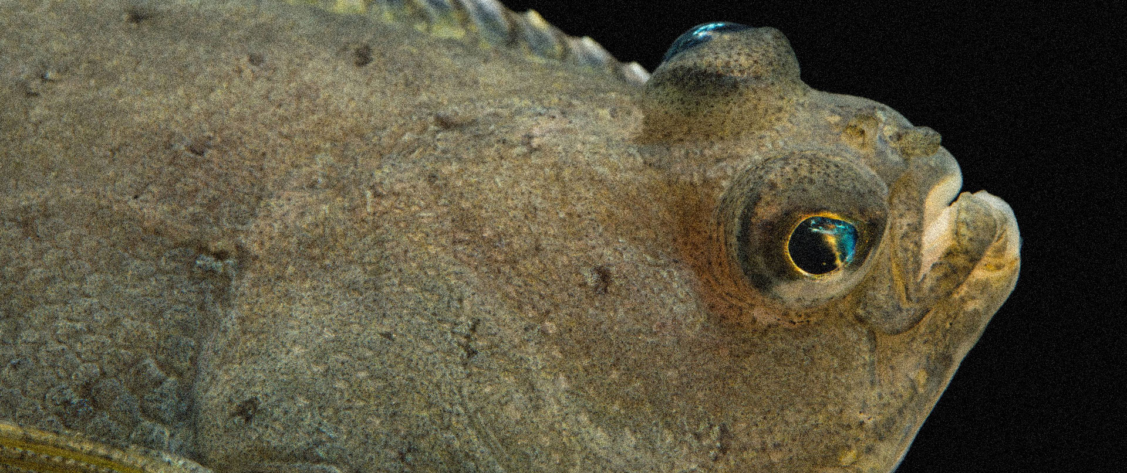
Questions?
Ingrid Spies

